Slide 1
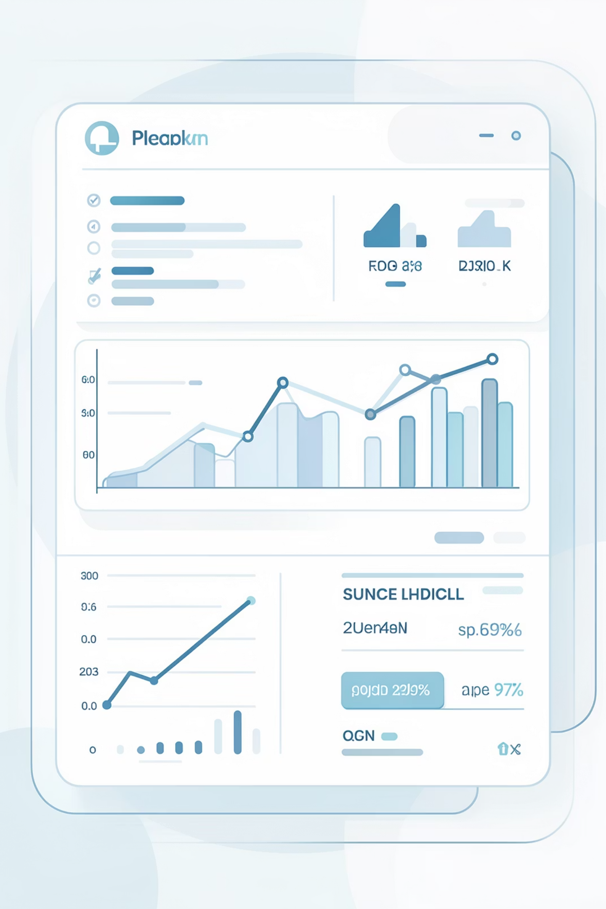
Elite Financial Intelligence Coach
AI-Powered Agentic Personal Finance System
5–7 Minute Overview

Slide 2
The Problem: Why Current Tools Fail
Lack of Visibility
Generic Advice
Users struggle with understanding their real spending behavior.
Financial guidance is static and not tailored to individual circumstances.
No Feasibility Analysis
Dashboard Paralysis
Savings goals often lack concrete plans or realistic assessments.
Data visualization doesn't always translate into actionable financial decisions.

Slide 3

Our Solution: An Agentic AI Coach
Ingests raw transaction data (CSV/XLSX) for accurate analysis.
Anchors insights directly in real financial behavior, not assumptions.
Utilizes specialized AI agents with distinct personas for varied perspectives.
Produces decision-grade, explainable insights for clear actions.

Slide 4






Core Features
Smart Data Ingestion
90-Day Spend Analysis
Handles messy bank exports with ease.
Rolling analysis for dynamic spending insights.
Goal Feasibility & Gap Detection
Leakage & Expense Detection
Identifies savings shortfalls and achievable goals.
Pinpoints recurring expenses and financial inefficiencies.
Interactive Dashboard
AI-Generated Financial Audit
Visualizes projections and current financial health.
Comprehensive PDF reports for review.

Slide 5

System Architecture
Frontend: Streamlit
User interface and dashboards
Report Generation: FPDF
Data Processing: Pandas
Five-step Technical Stack
Data cleansing and transformation
PDF creation and export
Agent Framework: Agno
LLM: Groq LLaMA 3.1
Large language model inference
Orchestration and workflow agents
Our modular architecture ensures scalability, efficiency, and robust performance across all components.

Slide 6

Agentic Design with Personas
Personas: Conservative, Fun Saver, Analytical.
Same core financial math, presented with different reasoning styles.
Strict financial anchors prevent AI hallucination.
AI reasoning layers on top of deterministic computation for reliability.

Slide 7
Live Demo Flow
01
02
Select Advisor Persona
Upload Dataset
Choose the AI agent that best suits your financial outlook.
Use a dataset or use given sample synthetic financial transactions spreadsheet (synthetic_financial_transactions.xlsx).
03
04
Enter Goal & Income
Explore Dashboard
Define your financial goal, timeframe, and monthly income.
Interact with dynamic projections and financial insights.
05
06
Generate AI Audit
Download PDF Report
Receive a comprehensive, AI-generated financial report.
Access your personalized financial summary.

Slide 8




Key Learnings
Improved Explainability
Increased Trust
Agent-based systems enhance clarity in AI reasoning.
Anchoring AI to computed data builds user confidence.
Enhanced Engagement
Constrained LLM Performance
Personas significantly improve user interaction and adoption.
LLMs excel when constrained, not operating free-form.

Slide 9

Challenges Encountered
Inconsistent Transaction Schemas: Normalizing diverse bank export formats remains a significant hurdle.
Clarity vs. Verbosity: Balancing detailed AI output with concise, actionable insights for users.
Mathematical Correctness: Ensuring AI reasoning maintains absolute accuracy within financial computations.

Slide 10




Future Enhancements
Multi-Account Ingestion
Net Worth & Asset Tracking
Support for bank accounts, credit cards, and investment accounts.
Comprehensive overview of overall financial health.
Long-Term Forecasting
Multi-Agent Collaboration
Predictions with variable income and dynamic scenarios.
Integrated agents for budgeting, investing, and risk management.

